Slide 1
PLANT DISEASE DETECTION USING FEATURE EXTRACTION AND MULTICLASS-SVM
Under the Guidance of Dr. S Chitrakala
Professor/Department of CSE/College of Engineering Guindy

Slide 2
Introduction
Identification of the plant diseases is the key to preventing the losses in the yield and quantity of the agricultural product. Health monitoring and disease detection on plant is very critical for sustainable agriculture.
It is very difficult to monitor the plant diseases manually. It requires tremendous amount of work, expertise in the plant diseases, and also requires excessive processing time.
Hence, image processing and machine learning techniques are used for the detection of plant diseases in plants like potato, apple and tomato.
This project aims at identifying the disease of the plant with a photo of the diseased image as the input, the output being the name of the disease associated with the input image. This will enable farmers to identify disease of the plant even when they have no knowledge about it.

Slide 3
Objectives
To design and develop a Plant disease detection using feature extraction and machine learning techniques for various plants such as potato, apple and tomato.
To preprocess plant leaf image
To extract features from preprocessed leaf image
To classify leaf diseases for various plants as apple scab , early blight-potato

Slide 4
Literature Survey
S. No. | Base Paper | Methodology | Issues
1 | S.Arivazhagan, R. Newlin Shebiah, S.Ananthi, S.Vishnu Varthini. (2013) ―Detection of Unhealthy Region of Plant Leaves and Classification of Plant Leaf Diseases using Texture Features.‖ Agric Eng Int: CIGR Journal, 15(1): 211－217. | First a color transformation structure for the input RGB image is generated, and then the green pixels are marked and eliminated using specific threshold value followed by segmentation process, evaluating the texture features using color co-occurrence technique for the useful segments, finally the extracted features are proceed through the classifier. | The elimination of green pixels narrows down the results of the classifier as there are a few diseases that does not affect the color of the leaves, which may get unrecognised.
2 | Leaf disease detection on cucumber leaves using multiclass support vector machine IEEE International Conference on Wireless Communications, Signal Processing and Networking (2017), pp. 1276-1281 | Pre-processing was done by image resizing, contrast enhancement and color-space conversion. The K-Means clustering for segmentation and feature extraction using GLCM is performed. Classification was made using multiclass SVM. | Feature scaling of the extracted features was not performed, and this affected the performance of the multiclass SVM classifier.
3 | P. Moghadam, D. Ward, E. Goan, S. Jayawardena, P. Sikka and E. Hernandez, "Plant Disease Detection Using Hyperspectral Imaging," 2017 International Conference on Digital Image Computing: Techniques and Applications (DICTA), 2017, pp. 1-8, doi: 10.1109/DICTA.2017.8227476. | VNIR and SWIR spectrums were used in this research. Authors have used k-means clustering algorithm in spectral domain for the segmentation of leaf. They have proposed a novel grid removal algorithm to remove the grid from hyperspectral images. Authors have achieved the accuracy of 83% with vegetation indices in VNIR spectral range and 93% accuracy with full spectrum | Though the proposed method achieved higher accuracy, it requires the hyperspectral camera with 324 spectral bands so the solution becomes too costly and is not computationally efficient

Slide 5
Architecture Design
Feature Extraction
Images for Training
Pre Processing
Color features
Texture
features
Model Construction
Healthy Apple
Feature Extraction
Apple Scab
Image for Testing
Pre Processing
Color features
Texture
features
Classification
Early Blight - Potato
Healthy Potato

Slide 6
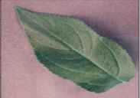
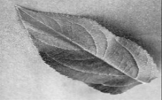
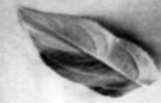


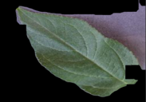
Architecture Diagram
Original Image
Greyscale conversion
Pre processing
Gaussian Filter
Otsu’s
Thresholding
Morphological Transform
Masking with Original Image

Slide 7
MODULES:
Our project has the following modules:
IMAGE PRE-PROCESSING
FEATURE EXTRACTION
BUILDING THE MACHINE LEARNING MODEL
PLANT DISEASE CLASSIFICATION

Slide 8
Pre Processing
Input:
Output:
Potential Diseased leaf Image
Preprocessed Image
Input: Leaf Image
Image contrast enhancement
Grayscale conversion
Gaussian filter
Image thresholding
Morphological closing
Edge detection using contours
Output:
Preprocessed image
Conversion of black background to white background
Mask image creation for background subtraction
Masking operation on original image
Background Subtraction

Slide 9
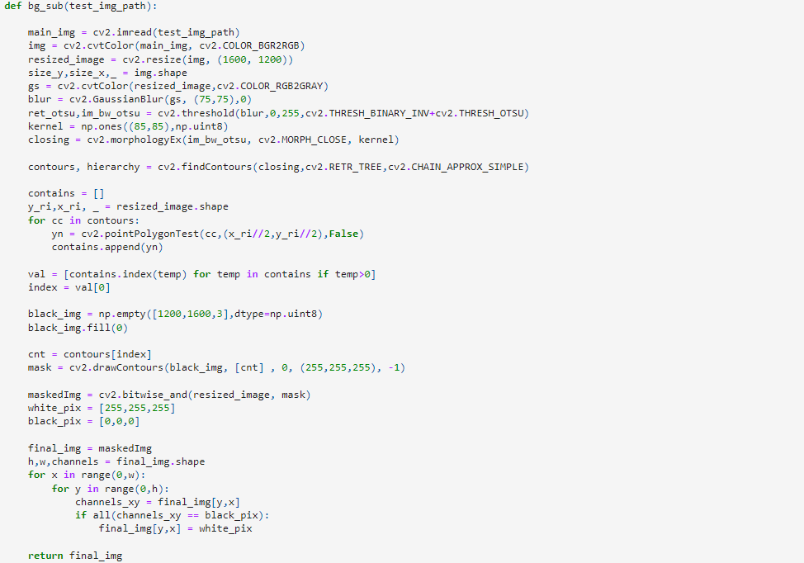

Slide 10
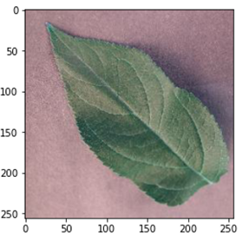
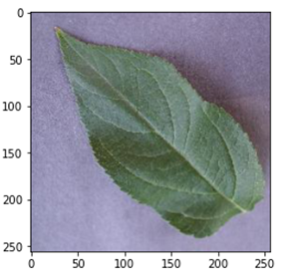
Pre Processing - Snapshots
CHANGING THE IMAGE CONTRAST : Grayscale simplifies the algorithm and reduces computational requirements.
Original Image:
Image after contrast:

Slide 11
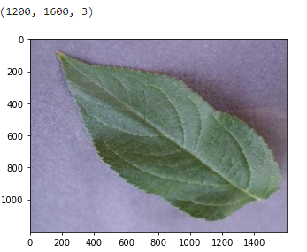
Pre Processing
2. RESIZING THE INPUT IMAGE

Slide 12
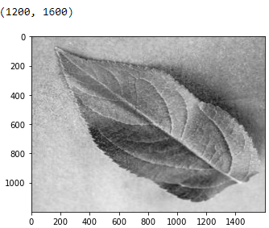
Pre Processing
3. CONVERTING IMAGE TO GRAY SCALE : grayscale simplifies the algorithm and reduces computational requirements.

Slide 13
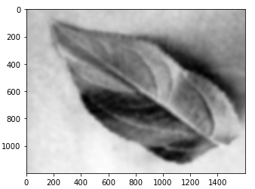
Pre Processing
4 .APPLYING GAUSSIAN BLUR : Its main purpose is removing noise from images.

Slide 14
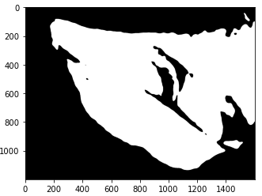
Pre Processing
5. PERFORMING OTSU’S IMAGE THRESHOLDING :
It is a way to create a binary image from a grayscale or full-color image. This is typically done in order to separate "object" or foreground pixels from background pixels to aid in image processing.

Slide 15
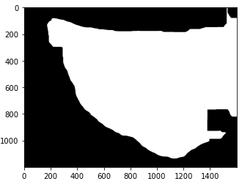
Pre Processing
6. USING MORPHOLOGY CLOSING :
Morphology Closing is useful in closing small holes inside the foreground objects, or small black points on the object.

Slide 16
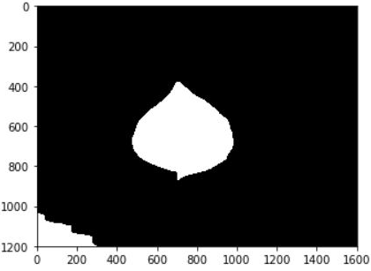
Pre Processing
7. EDGE DETECTION USING CONTOURS :
Contours is a curve joining all the continuous points(along the boundary), having same color or intensity. For better accuracy, we used binary images. So before finding contours, apply threshold.

Slide 17
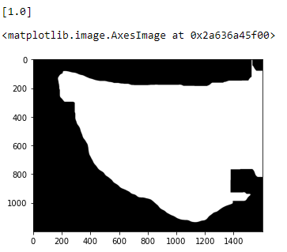
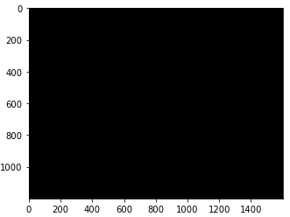
Pre Processing
8. Creating a mask image for background subtraction using leaf contour
Creating a black image with dimensions 1200 X 1600.

Slide 18
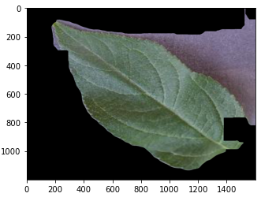
Pre Processing
9. PERFORMING MASKING OPERATION ON THE ORIGINAL IMAGE :
Here we are masking the original leaf image with our "mask" image.

Slide 19
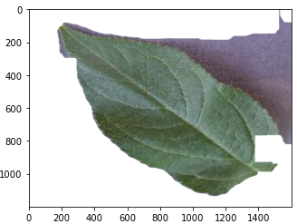
Pre Processing
10. Conversion of black background to white background

Slide 20
Feature Extraction
Input:
Output:
Preprocessed leaf image
Feature vectors
Input :
Preprocessed
image
Output :
Feature
Vectors
entropy
contrast
mean
standard
deviation
correlation
IDM
Color channel image descriptor
Texture based feature

Slide 21
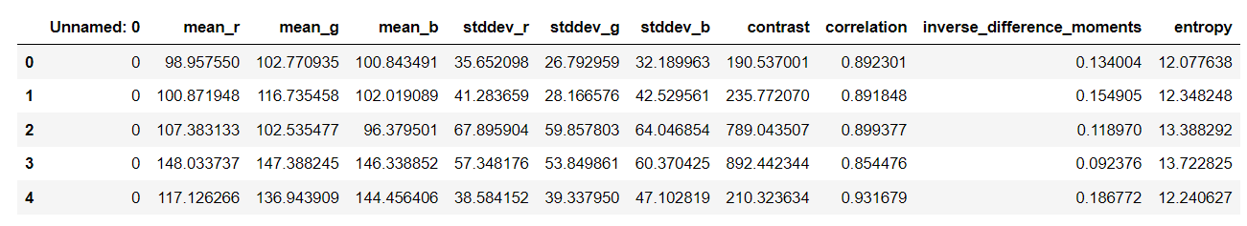
Color and Texture Based Feature Extraction - Snapshot :

Slide 22
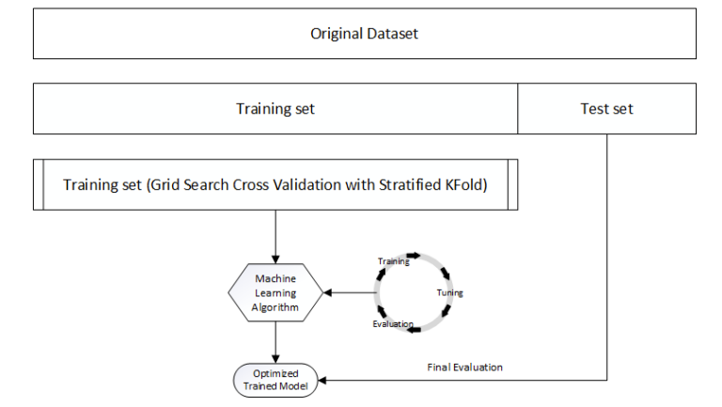
Building and Evaluating the Model

Slide 23
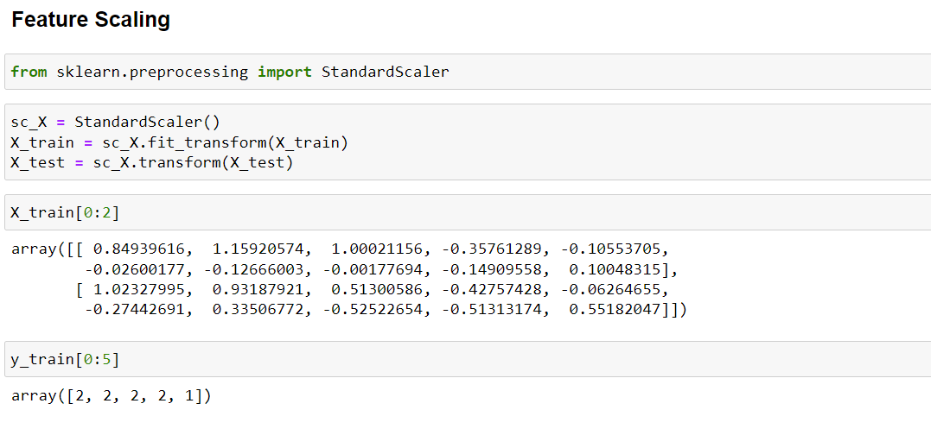
Feature Scaling

Slide 24
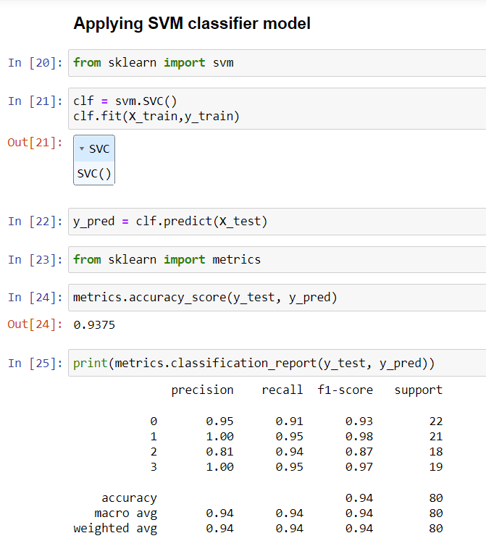
SVM Classifier

Slide 25
Dataset
For our implementation, we will train and test our model with the Kaggle Dataset
Image acquisition is the action of retrieving an image from a source and the image that is acquired will be completely unprocessed. Images for different categories of the dataset were obtained from a library under:
Kaggle-https://www.kaggle.com/datasets/vipoooool/new-plant-diseases dataset?resource=download. These obtained plant data set is called as training data set. Once training data set has been processed, appending is done to the test image of the plant part. Noise could be introduced during the image acquisition process or electronic transmission of the images. Noisy images changes the pixel values of the original that affected the real image intensities.

Slide 26
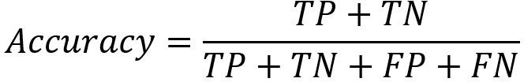
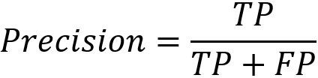

Performance Metrics
Accuracy: the proportion of true results(both true positives and true negatives) among the total number of cases examined
Precision (also called positive predictive value) - the fraction of relevant instances among the retrieved instances.
Recall (also known as sensitivity) - the fraction of the total amount of relevant instances that were actually retrieved.
F1-score - the weighted harmonic mean of the test's precision and recall.

Slide 27
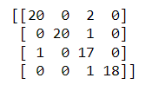
Performance Analysis Of The Model
We have used a multiclass SVM classifier, and to evaluate it’s performance the corresponding confusion matrix is taken into consideration :
The numbers outside the confusion matrix
refer to the encoded labels of each class :
0 : Represents Apple Scab
1 : Represents a Healthy Apple
2 : Represents Potato Blight
3 : Represents a Healthy Potato
PREDICTED VALUES
0 1 2 3
ACTUAL VALUES
0
1
2
3

Slide 28
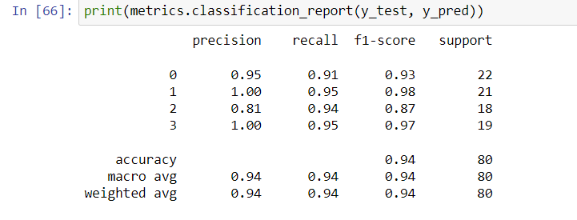
Classification Report Of The Model

Slide 29
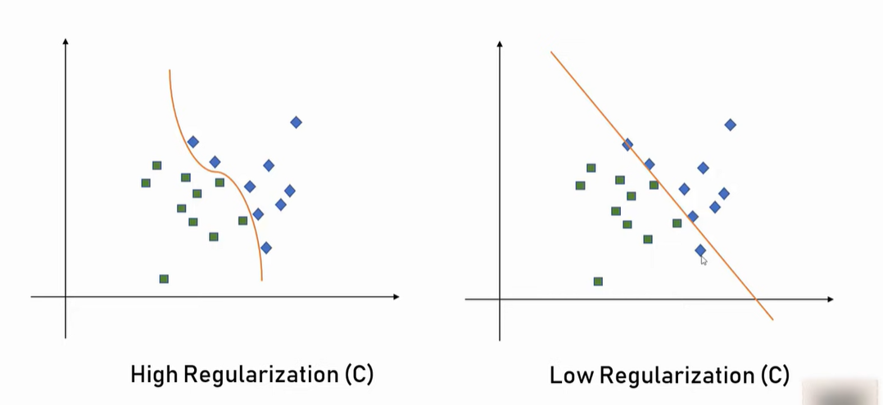
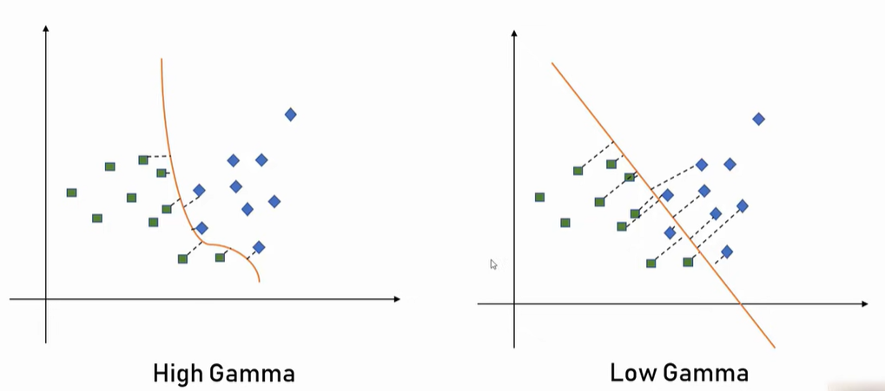
Hyperparameters OF The SVM Classifier
SVM has 3 primary hyperparameters
that affect its performance:
1. Choice Of Kernel :
i)Linear
ii)RBF(Radial Basis Function)
2. Value of Regularization parameter (C)
3. Value of Gamma

Slide 30
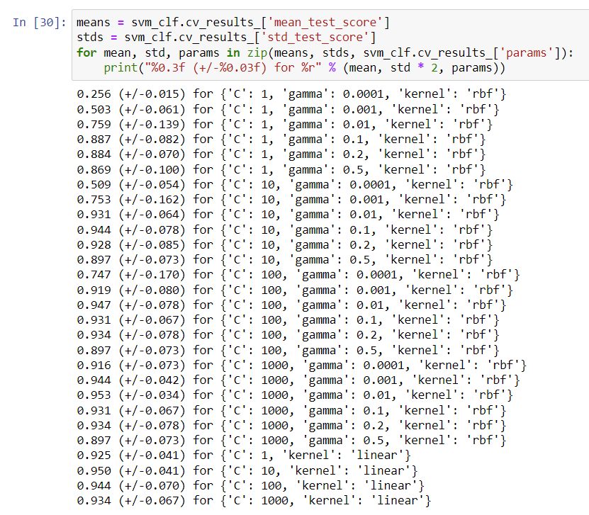
Hyperparameter Tuning Using GridsearchCV

Slide 31
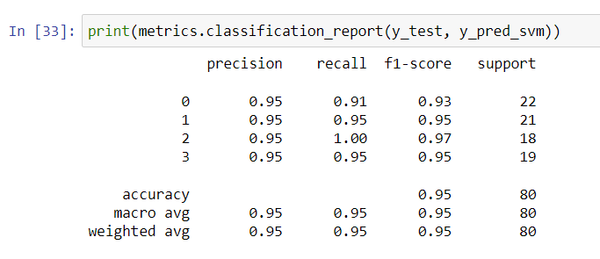
Performance Of The Model After Optimization

Slide 32
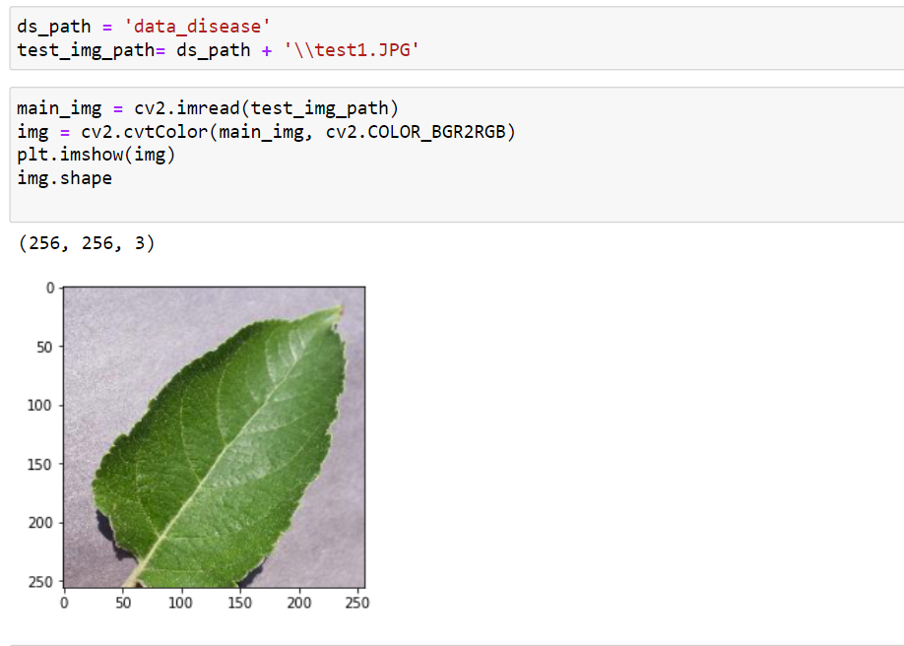
Test-1 : An image of a leaf from a healthy apple tree was taken and fed into the model.
Importing Test Image

Slide 33
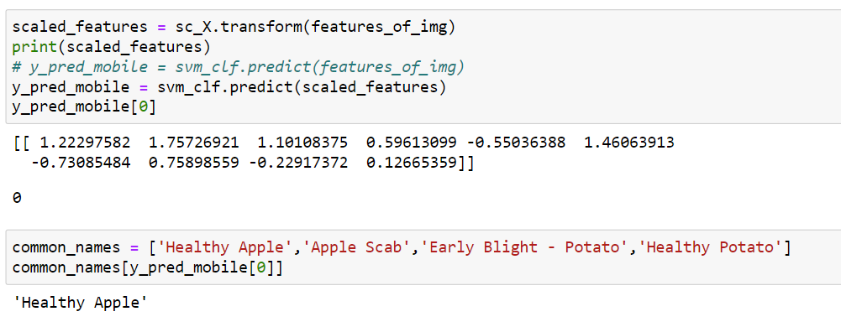
Prediction Made by the Classifier For Test image 1
Conclusion : The classifier is successful in the first Test case.

Slide 34
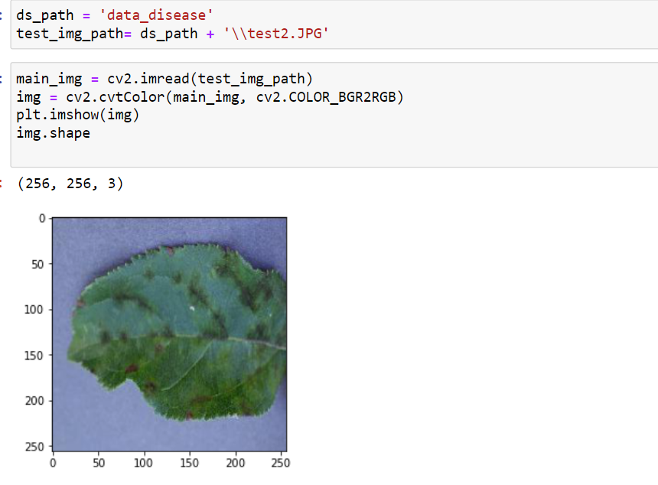
Test-2 : An image of a leaf from an apple tree infected with Apple Scab was Taken and fed into the model.
Importing Test Image

Slide 35
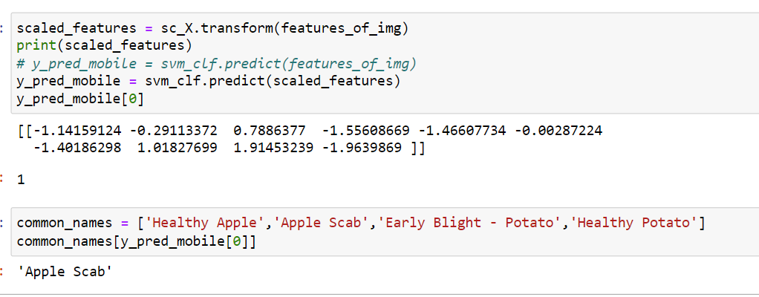
Prediction Made by the Classifier For Test image 2
Conclusion : The classifier is successful in the second Test case.

Slide 36
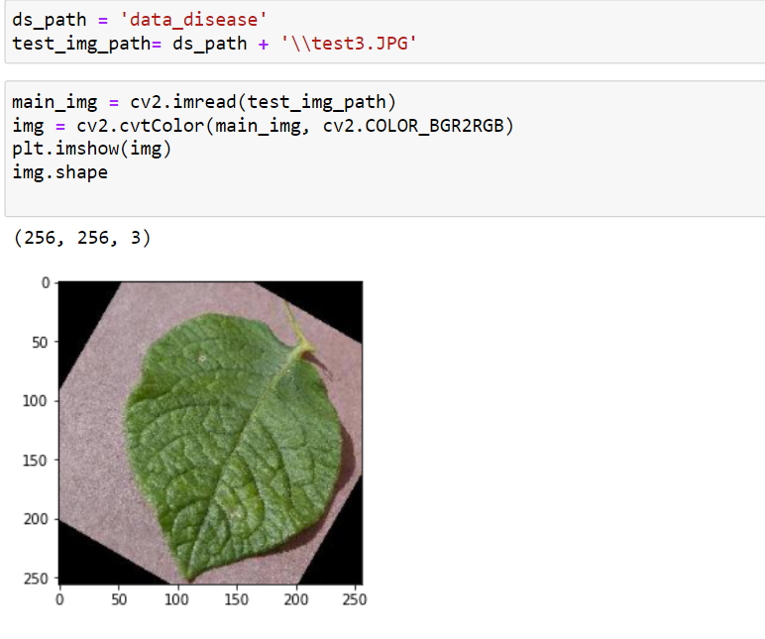
Test-3 : An image of a leaf from a healthy potato plant was taken and fed into the model.
Importing Test Image

Slide 37
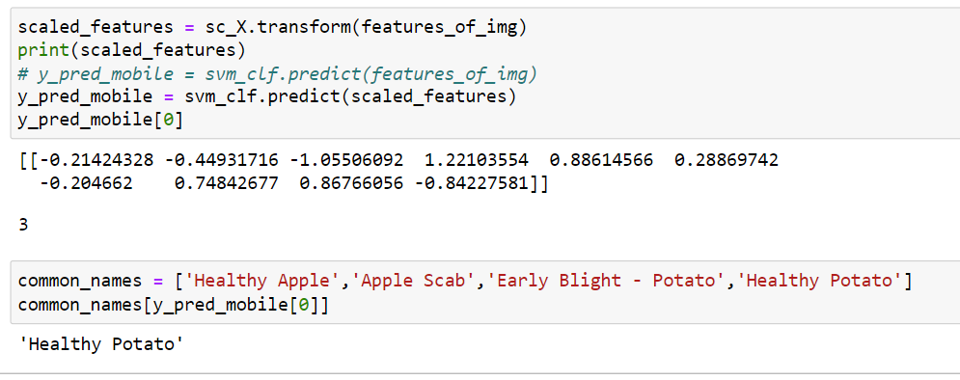
Prediction Made by the Classifier For Test image 3
Conclusion : The classifier is successful in the third Test case.

Slide 38
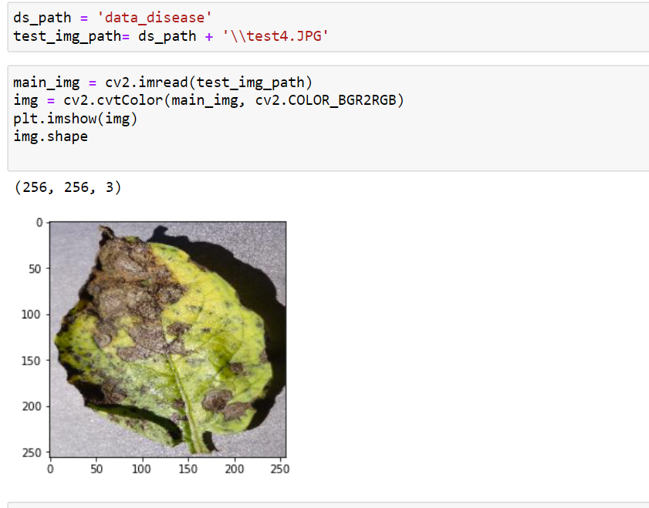
Test-4 : An image of a leaf from a diseased potato plant (Early Blight) was taken and fed into the model.
Importing Test Image

Slide 39
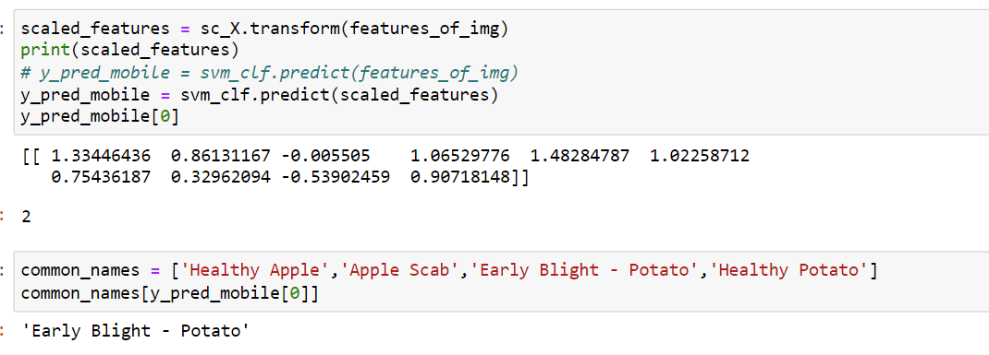
Prediction Made by the Classifier For Test image 4
Conclusion : The classifier is successful in the fourth Test case.

Slide 40
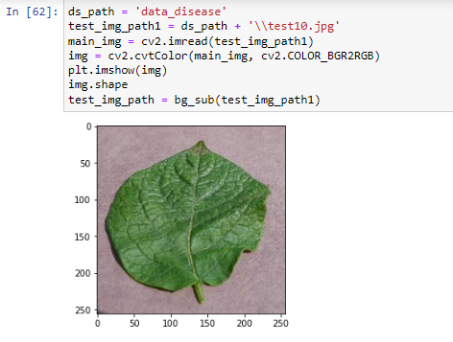
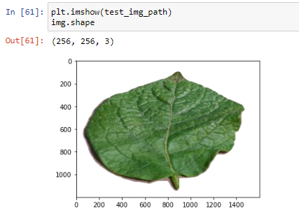
Test-5 : An image of a leaf from a healthy potato plant was taken and fed into the model
Importing test image 5 with background filter

Slide 41
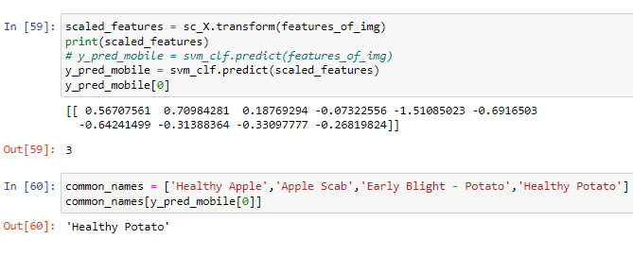
Prediction Made by the Classifier For Test image 5
Conclusion : The classifier is successful in the fifth Test case.

Slide 42
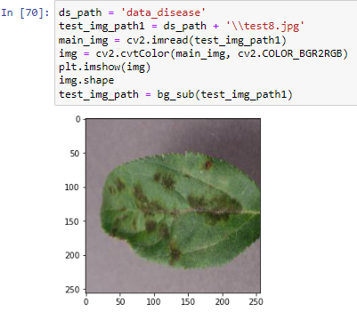
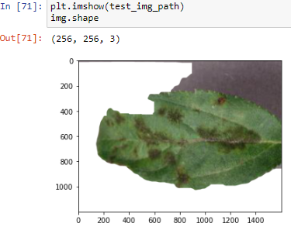
Test-6 : An image of a leaf from a diseased apple plant (apple scab) was taken and fed into the model.
Importing test image 6 with background filter

Slide 43
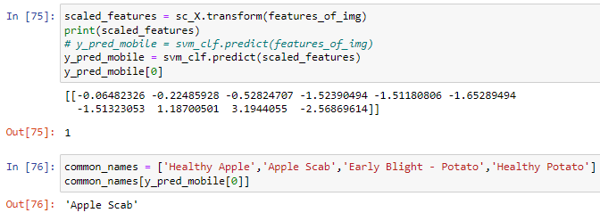
Prediction Made by the Classifier For Test image 6
Conclusion : The classifier is successful in the sixth Test case.

Slide 44
References
[1] Divyanshu Varshney; Burhanuddin Babukhanwala; Javed Khan; Deepika Saxena; Ashutosh Kumar Singh,“Plant Disease Detection using Machine Learning Techniques” in the Proceedings of 2022 3rd international conference for Emerging Technology (INCET) DOI : http://dx.doi.org/10.1109/INCET54531.2022.9824653
[2] Abirami Devaraj, Karunya Rathan, Sarvepalli Jaahnavi, and K Indira, “Identification of Plant Disease using Image Processing Technique”, International Conference on Communication and Signal Processing, April 4-6, 2019.
[3] Mohammed Hussein and A. H. Abbas, “Plant Leaf Disease Detection Using Support Vector Machine”, MJS, vol. 30, no. 1, pp. 105–110, Aug. 2019. DOI: https://doi.org/10.23851/mjs.v30i1.487
[4] Prabhjeet Kaur, Sanjay Singla, Sukhdeep Singh, “Detection and classification of leaf diseases using an integrated approach of support vector machine and particle swarm optimization”, International Journal of Advanced and Applied Sciences, 2017.
[5] Vishal Mani Tiwari&Tarun Gupta “Plant Leaf Disease Analysis using Image Processing Technique with Modified SVM-CS Classifier” Research Gate2017.
[6] Ijai Singh, A. K Misra,” Detection of plant leaf diseases using image segmentation and soft computing techniques”, Volume 4, Issue 1, March 2017.
[7] Sonal P. Patil, Ms. Rupali S.Zambre,“Classification of Cotton Leaf Spot Disease Using Support Vector Machine”, International Journal of Engineering Research and Applications, ISSN: 2248-9622, Vol. 4, Issue 5, May 2014, pp.92-97.

Slide 45
Thank You

